Slide 1
Lecture-1
Python Introduction

Slide 2
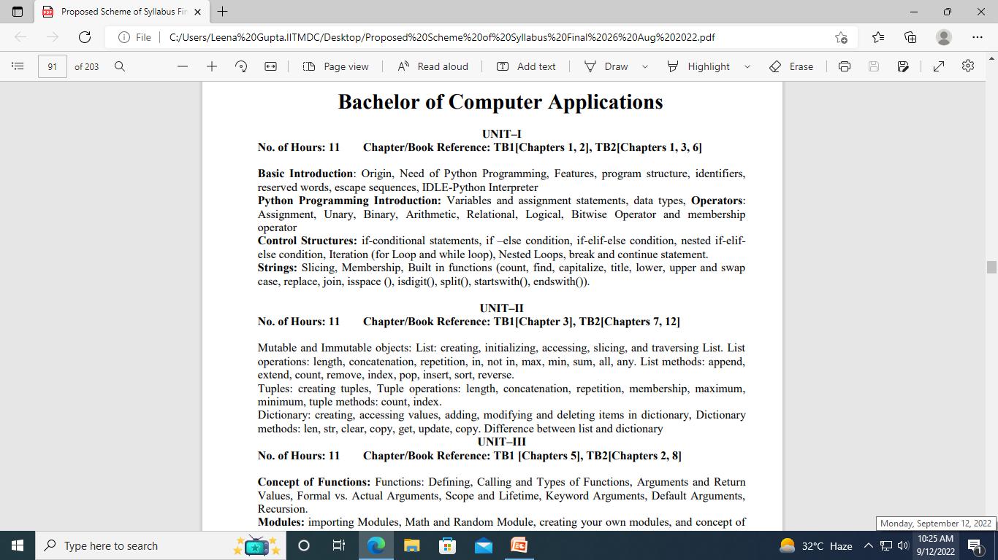

Slide 3
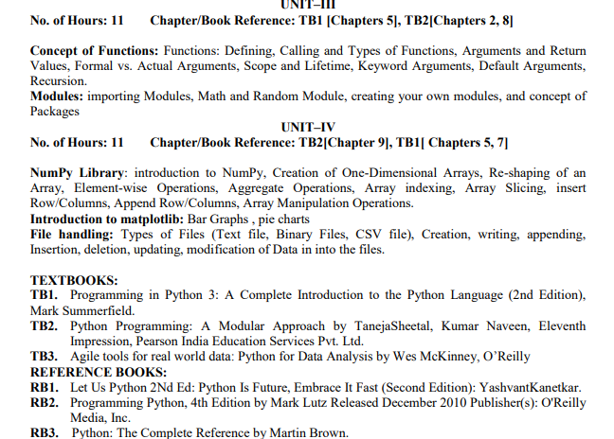

Slide 4
Introduction
Python is a widely used general-purpose, high level programming language.
It was initially designed by Guido van Rossum in 1991 and developed by Python Software Foundation.
It was mainly developed for emphasis on code readability, and its syntax allows programmers to express concepts in fewer lines of code.
Python is a programming language that lets you work quickly and integrate systems more efficiently.

Slide 5
There are two major Python versions-
Python 2 and Python 3
On 16 October 2000, Python 2.0 was released with many new features. •
On 3rd December 2008, Python 3.0 was released with more testing and includes new features.

Slide 6
Beginning with Python programming:
1) Finding an Interpreter: we need to have an interpreter to interpret and run our programs. There are certain online interpreters like https://ide.geeksforgeeks.org/, http://ideone.com/ or http://codepad.org/ that can be used to start Python without installing an interpreter.
Windows:
There are many interpreters available freely to run Python scripts like IDLE (Integrated Development Environment) which is installed when you install the python software from http://python.org/downloads/

Slide 7
Why to use Python:
The following are the primary factors to use python in day-to-day life:
Python is object-oriented Structure supports such concepts as polymorphism, operation overloading and multiple inheritance.
2. Indentation Indentation is one of the greatest feature in python
3. It’s free (open source) Downloading python and installing python is free and easy .
4. It’s Powerful
Dynamic typing
Built-in types and tools
Library utilities
Third party utilities (e.g. Numeric, NumPy, sciPy)
Automatic memory management
.

Slide 8
5. It’s Portable
Python runs virtually every major platform used today
As long as you have a compatible python interpreter installed, python programs will run in exactly the same manner, irrespective of platform
6. It’s easy to use and learn
No intermediate compile
Python Programs are compiled automatically to an intermediate form called byte code, which the interpreter then reads.
This gives python the development speed of an interpreter without the performance loss inherent in purely interpreted languages.
Structure and syntax are pretty intuitive and easy to gras

Slide 9
7. Interpreted Language Python is processed at runtime by python Interpreter
8. Interactive Programming Language Users can interact with the python interpreter directly for writing the programs
9. Straight forward syntax The formation of python syntax is simple and straight forward which also makes it popular.

Slide 10
Installation:
There are many interpreters available freely to run Python scripts like IDLE (Integrated Development Environment) which is installed when you install the python software from http://python.org/downloads/
Steps to be followed and remembered:
Step 1: Select Version of Python to Install.
Step 2: Download Python Executable Installer.
Step 3: Run Executable Installer.
Step 4: Verify Python Was Installed On Windows
Step 5: Verify Pip Was Installed.
Step 6: Add Python Path to Environment Variables (Optional)

Slide 11
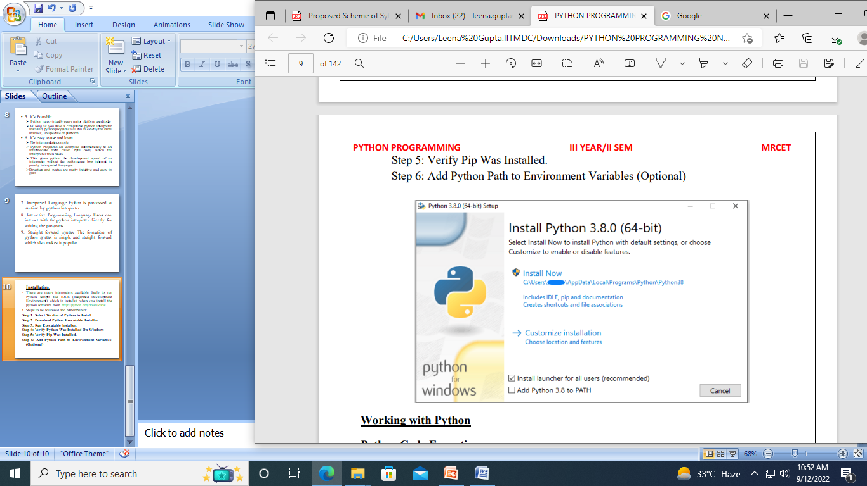

Slide 12
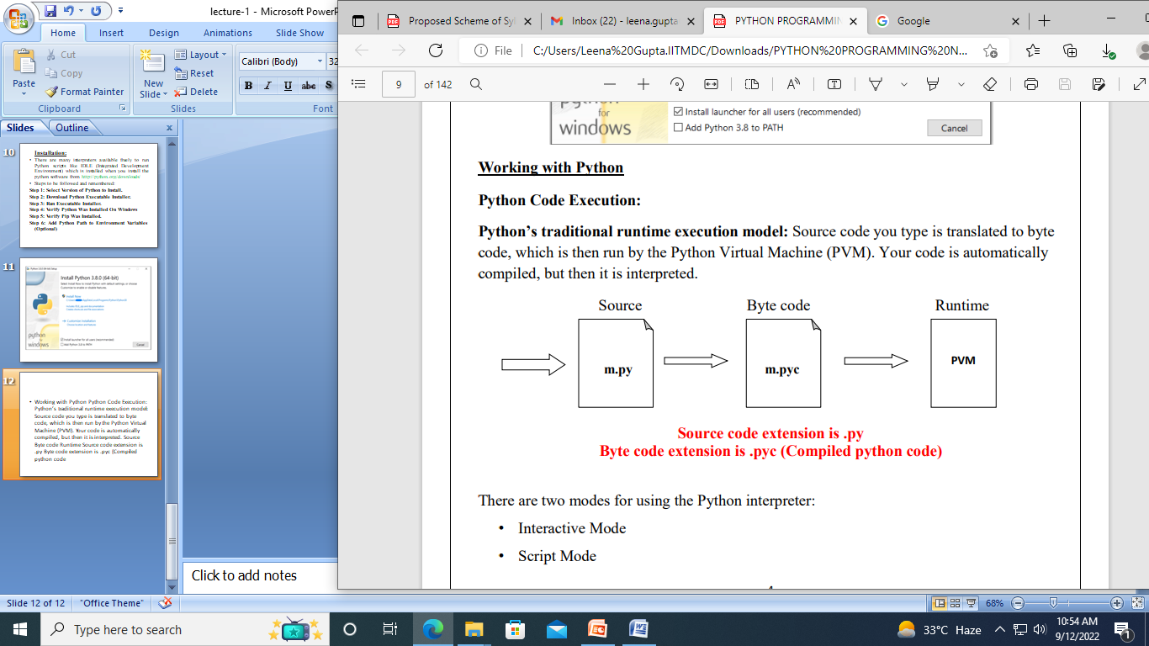
Working with Python -Python Code Execution: -
Python’s traditional runtime execution model: Source code you type is translated to byte code, which is then run by the Python Virtual Machine (PVM).
Your code is automatically compiled, but then it is interpreted.

Slide 13
There are two modes for using the Python interpreter:
Interactive Mode
Script Mode
Running Python in interactive mode:
Without passing python script file to the interpreter, directly execute code to Python prompt. Once you’re inside the python interpreter, then you can start.
>>> print("hello world")
hello world

Slide 14
Running Python in script mode:
Alternatively, programmers can store Python script source code in a file with the .py extension, and use the interpreter to execute the contents of the file.
To execute the script by the interpreter, you have to tell the interpreter the name of the file.
For example, if you have a script name MyFile.py and you're working on Unix, to run the script you have to type:
python MyFile.py
Note:-Working with the interactive mode is better when Python programmers deal with small pieces of code as you can type and execute them immediately, but when the code is more than 2-4 lines, using the script for coding can help to modify and use the code in future

